Slide 1

EDA on Adult income Data
Sai Varun Kollipara – C0828403
Bhanu Prakash Mahadevuni – C0850515
Deeksha Naikap – C0835440
Pramod Reddy Gurrala – C0850493

Slide 2
Problem Statement
The problem statement is to perform exploratory data analysis on the given datasets by following the reference link provided.
The datasets provided are the Heart Disease Data Set and Adult Data Set, and for the study, we have selected the Adult Data Set.

Slide 3
Steps involved
Here are the steps for performing Exploratory Data Analysis
Importing the packages and libraries
Loading the dataset
Data Understanding
Data Pre-Processing
Data Cleaning
Data Visualizations
Data Analysis

Slide 4
What is eda?
Exploratory Data Analysis (EDA) gathers insights into the dataset by using graphs/charts/python functions. The EDA should be mandatory for better data to perform advanced analyses like data modeling, machine learning model implementation, and predictions.
Here are some of the EDA that can be performed:
Check data shape (num of Rows & Columns)
Check each data type of column and missing values.
Splitting values.
Change the data type.
Check the percentages of missing values.
Summary Statistics.
Check value counts for a specific column.
Check duplicate values and deal with them.

Slide 5
Adult income data
Adult Data Set comprises the information of the 48842 people about personal, education, and financial details.
The implementation that can be done on this dataset is the prediction of the income of a person based on the information collected. The categories that can be gathered are the people with income less than 50K and more than 50K.
Dataset Link: https://archive.ics.uci.edu/ml/datasets/adult

Slide 6
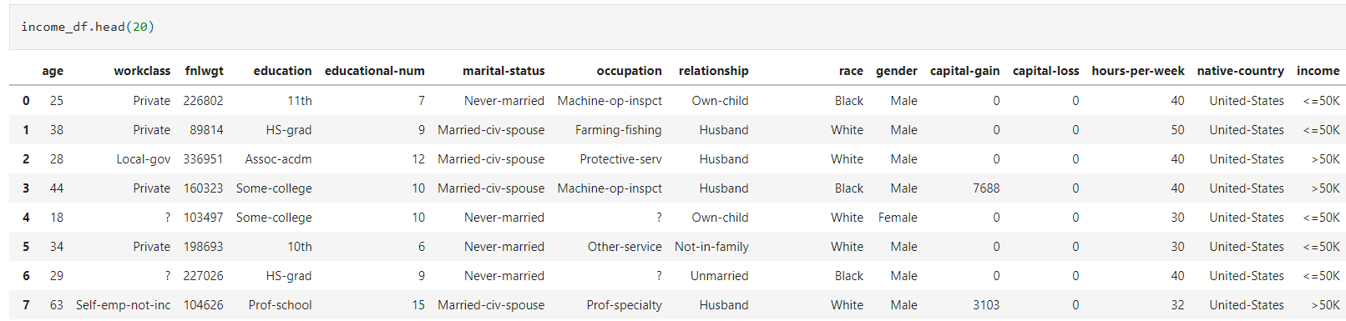
Data understanding
In the data understanding, loading the data, saving the data into a new variable, and visualizing the data are performed. Some basic functions like head and tail are used for viewing the data.
Viewing the top 20 records using the head function

Slide 7

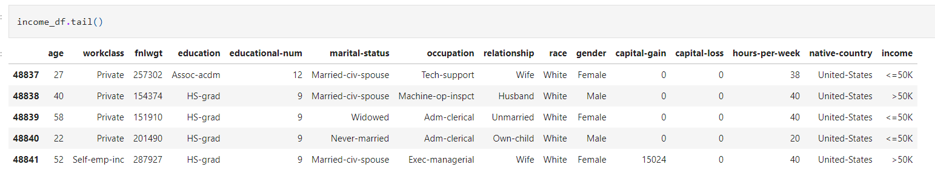
Data understanding
Loaded the data into income_df variable
Viewing the last records using tail function

Slide 8
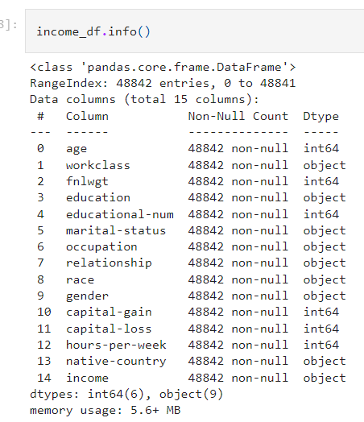
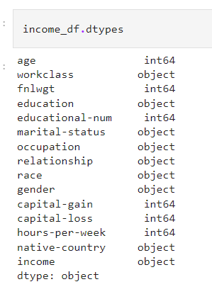
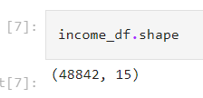
Data preprocessing
Shape of the dataset
Information only about datatypes
All information about dataset

Slide 9
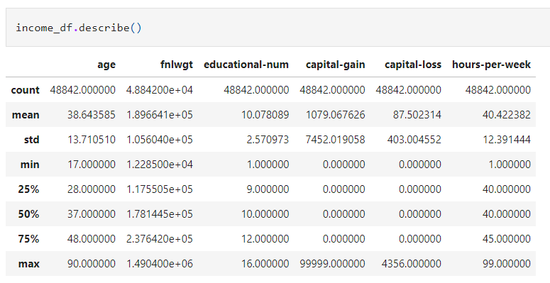
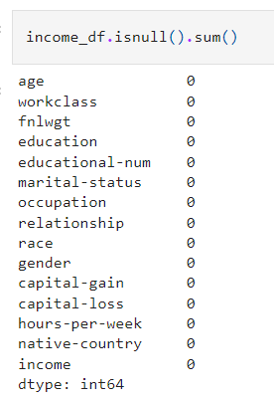
Data preprocessing
Statistical Analysis on the dataset
Checking for null values

Slide 10
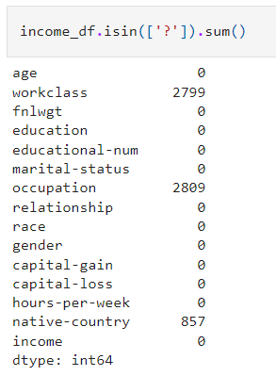
Data preprocessing
Even though the function says that no null values are present, while viewing the data, there are multiple records that contain ‘?’.
For that reason, the code to identify the number of records with that symbol is calculated and displayed.
Records with ‘?’

Slide 11

Data cleaning
There are multiple ways to perform data cleaning. For this case we are performing the following:
Dropping Columns
Imputation
Removing the Duplication
Since we are working in multiple phases, we have created a additional variable to perform the analysis

Slide 12
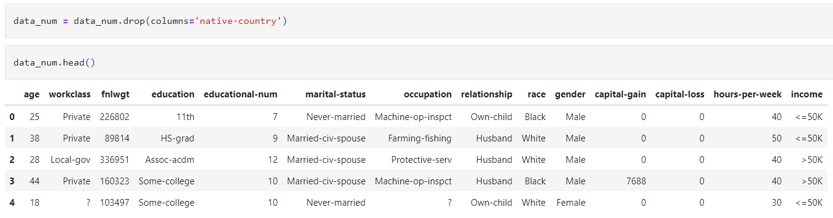
Data cleaning
We have dropped the native-country column, since we are performing fewer analysis using this attribute.

Slide 13
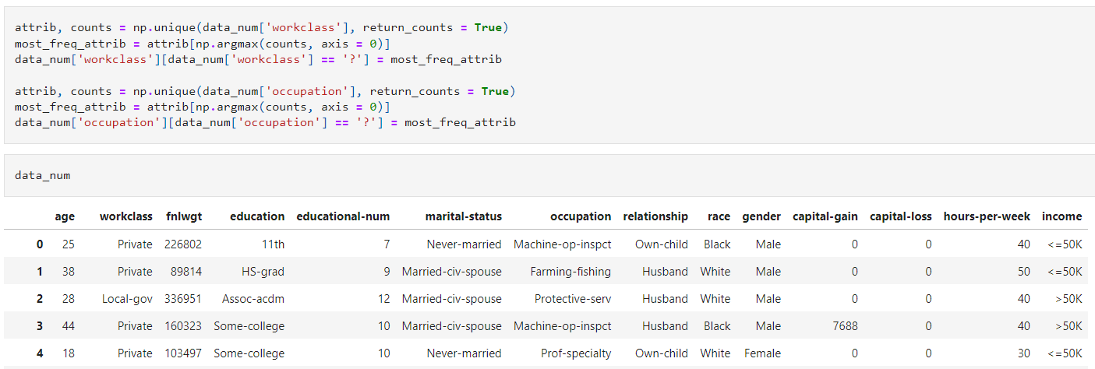
Data cleaning
We have performed imputation techniques for filling the records with ‘?’ symbol.

Slide 14
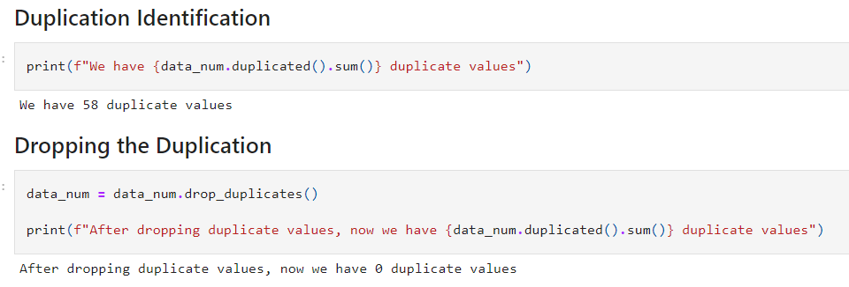
Data cleaning
We have calculated the number of duplicate values And have removed the recodes with the duplicate values.

Slide 15
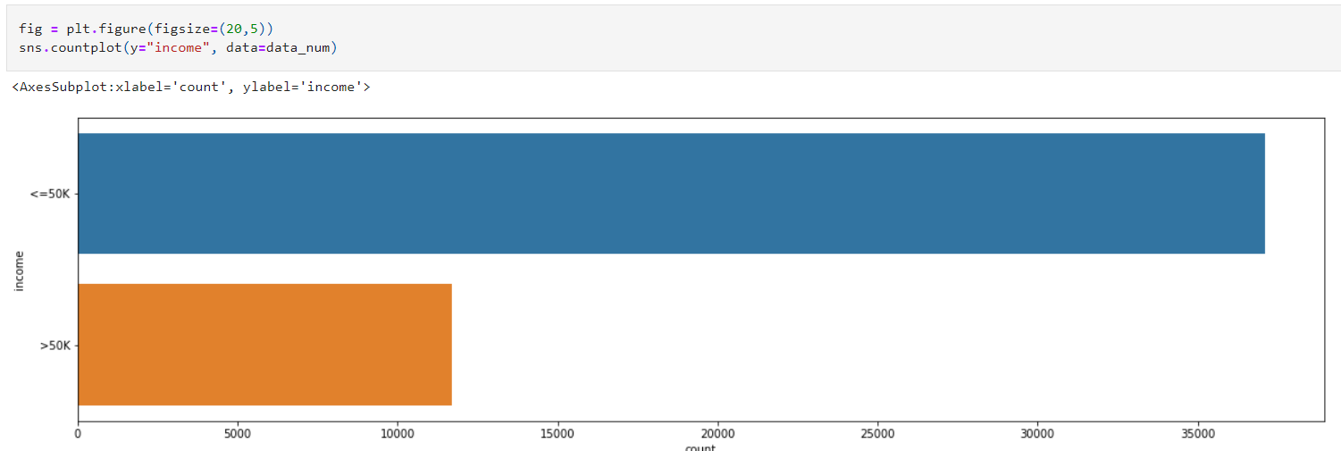
Data visualization
Count-Plot on the income attribute.

Slide 16
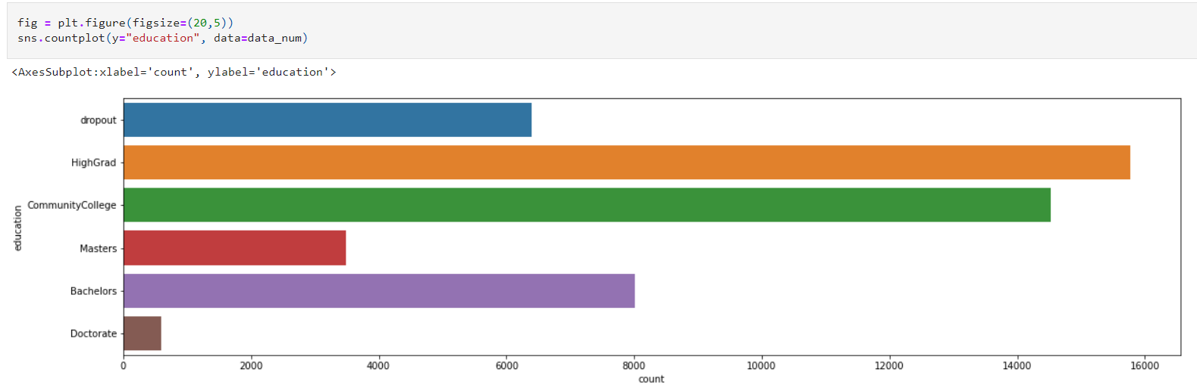
Data visualization
Performed feature engineering and performed count-plot on education attribute.

Slide 17
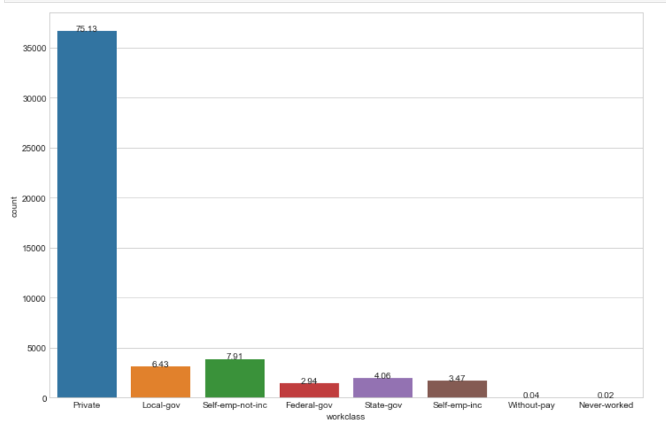
Data visualization

Slide 18
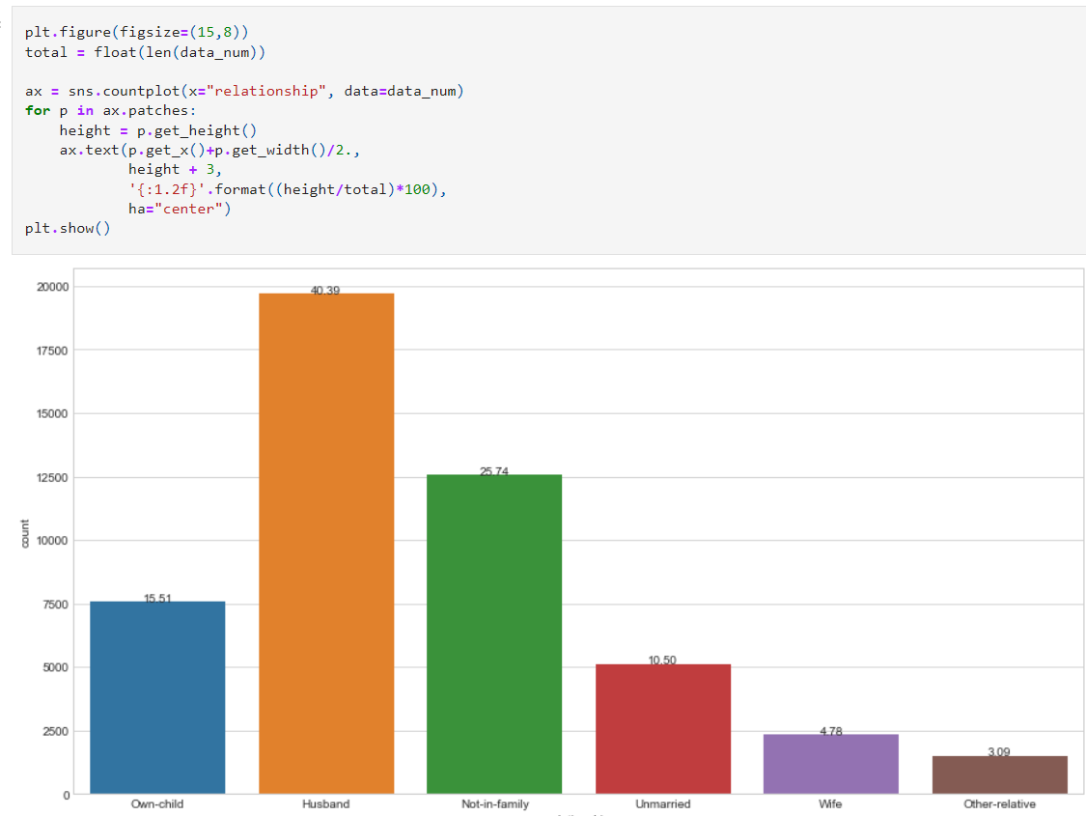
Data visualization

Slide 19
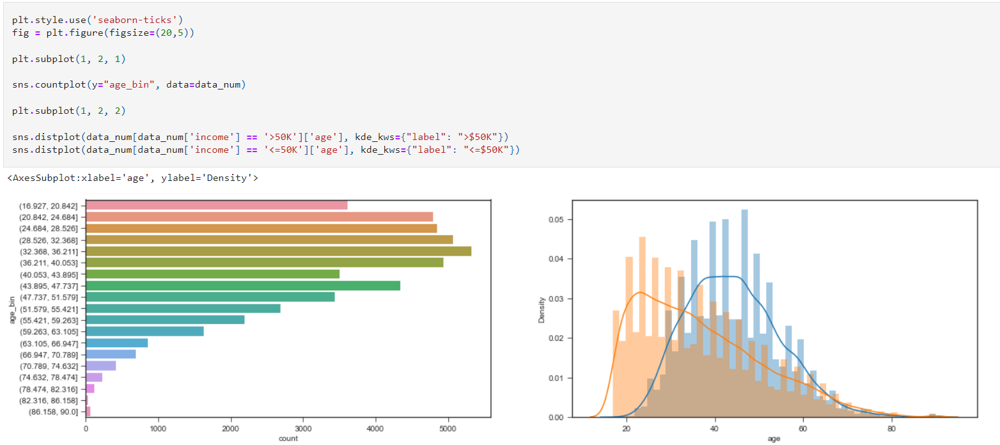
Data visualization
Created the plot function to perform both count plot and density plot.

Slide 20
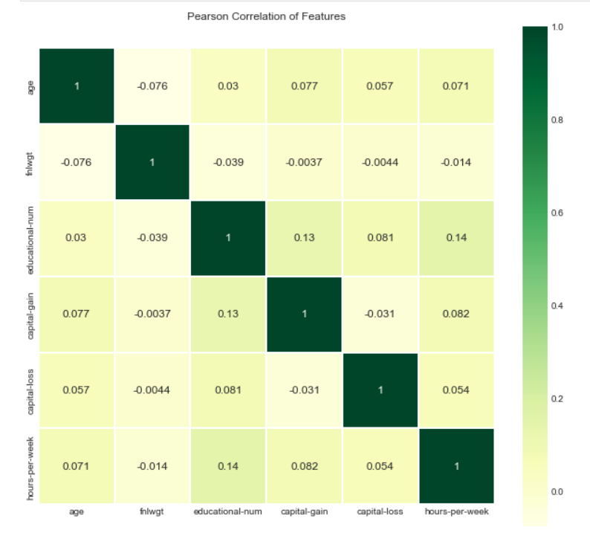
Data visualization
Correlation heatmap between the attributes

Slide 21
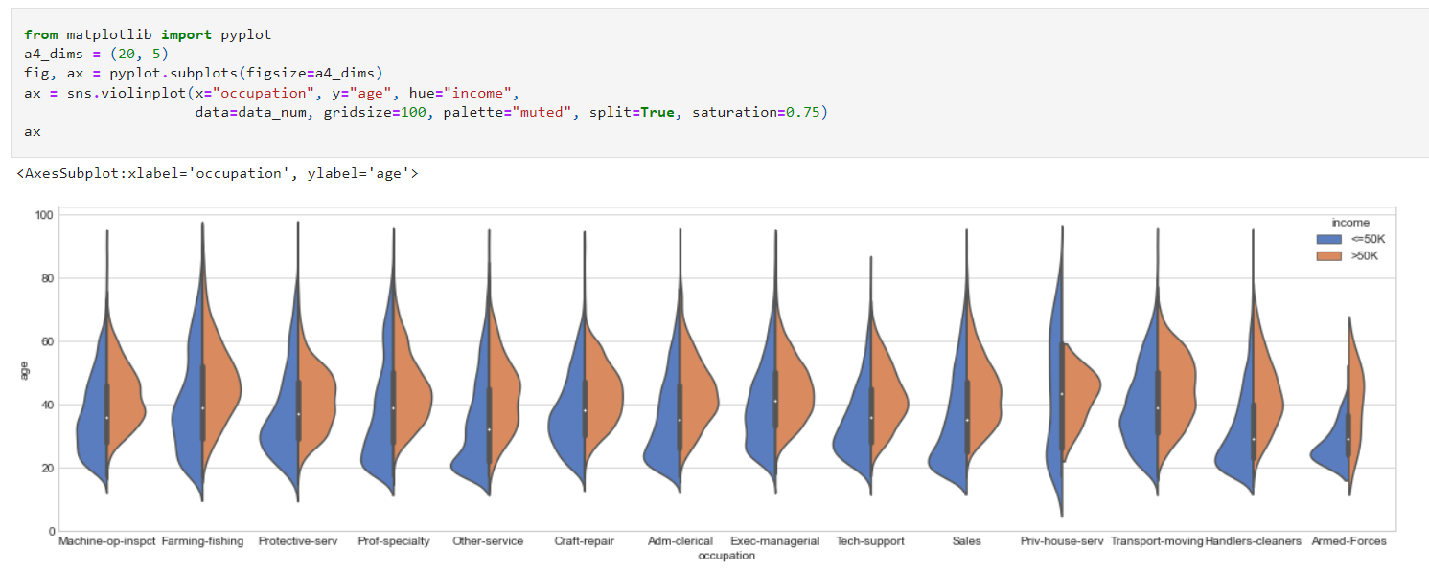
Bivariant analysis
The analysis that is performed by using more than two attributes is considered as the bivariant analysis. In this example we have performed violine plot using occupation, age and income.

Slide 22
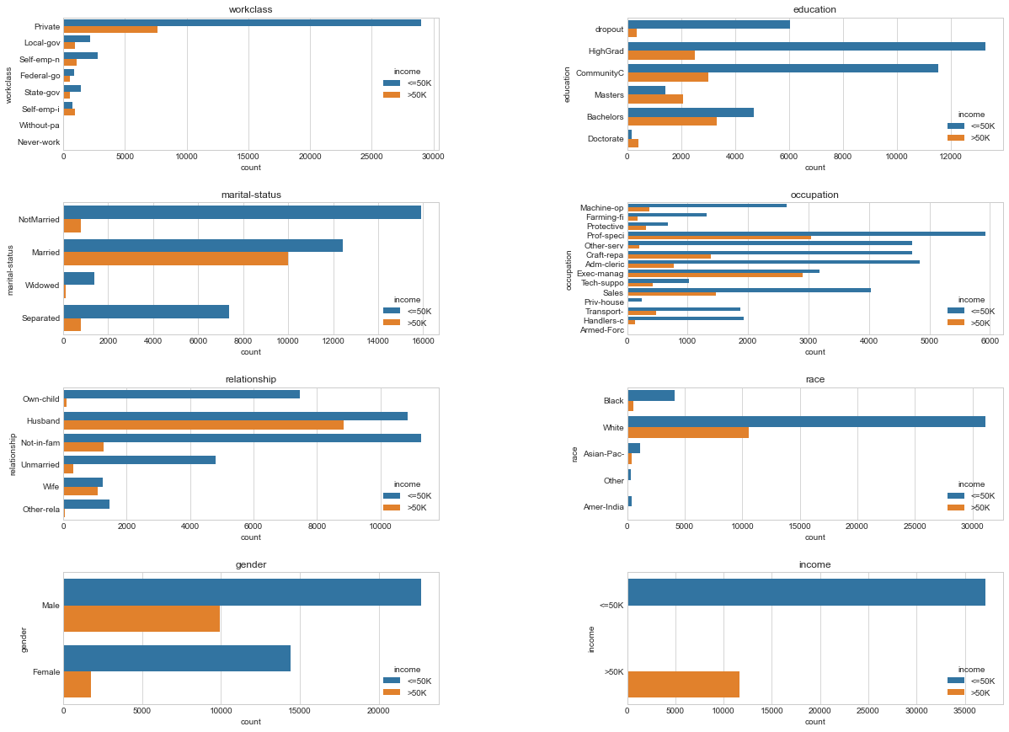
Bivariant analysis

Slide 23
Future developments
Since the basic data pre-processing steps are completed now the further steps like data splitting, data modeling, machine learning algorithm implementation and prediction are done.
For the prediction we can perform classification using the following algorithms:
KNN (K-nearest neighbour)
Random Forest

Slide 24
conclusion
We have identified the dataset consists of some error data and performed the following the over-come it.
Incorrect Data – Dropping the Columns and Imputation (filling with most frequent attributes since string).
Duplicate Data – Identifies the duplicate the records and dropped the records.
To identify the relationship between the features, we have created the correlation heat-map and performed the bivariant analysis.
We have identified the relationship between the age and income with density graph.
We have identified the attributes that are directly proportional using correlation matrix.

Slide 25
references
https://archive.ics.uci.edu/ml/datasets/adult
https://www.kaggle.com/code/pmarcelino/comprehensive-data-exploration-with-python/notebook
https://towardsdatascience.com/all-about-missing-data-handling-b94b8b5d2184
https://www.journaldev.com/53190/exploratory-data-analysis-python
https://medium.com/data-folks-indonesia/10-things-to-do-when-conducting-your-exploratory-data-analysis-eda-7e3b2dfbf812
https://www.kaggle.com/pmarcelino/comprehensive-data-exploration-with-python

